Slide 1
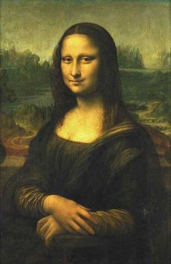
The Renaissance and Reformation

Slide 2
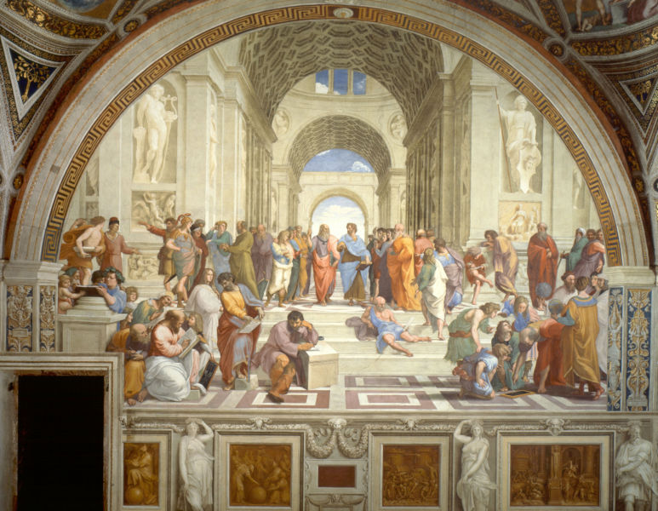
The Renaissance in Italy
The Renaissance – A time of creativity and change in many areas
Political
Social
Economic
cultural
Begins in Italy
Italians wanted to revive the culture of ancient Rome

Slide 3
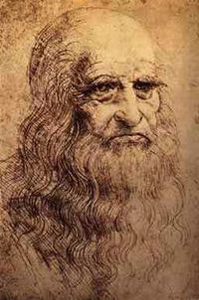
The Renaissance in Italy
Led by a wealthy and powerful merchant class
Stressed education and individual achievement
Spent lavishly to support the arts
Florence was the heart of the Renaissance
Produced many great poets, artists, architects, scholars and scientists
Notes:
Da Vinci

Slide 4
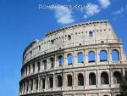
The Renaissance
A New Worldview
A renewed interest in ancient Greece and Rome
Caused by the disorder and disunity of the medieval world
Concentrated on life and achievement rather than the afterlife
A Spirit of Adventure
Christopher Columbus
Nicolaus Copernicus

Slide 5
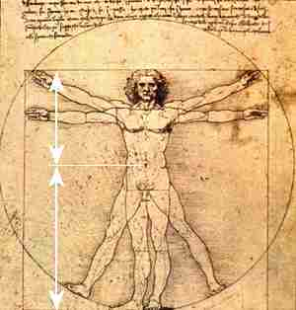
The Renaissance
Humanism
Focused on worldly subjects rather than religious issues
Art
Medieval – religious based
Renaissance – human based
Renaissance artist’s used perspective
Notes:
Draw a cube

Slide 6
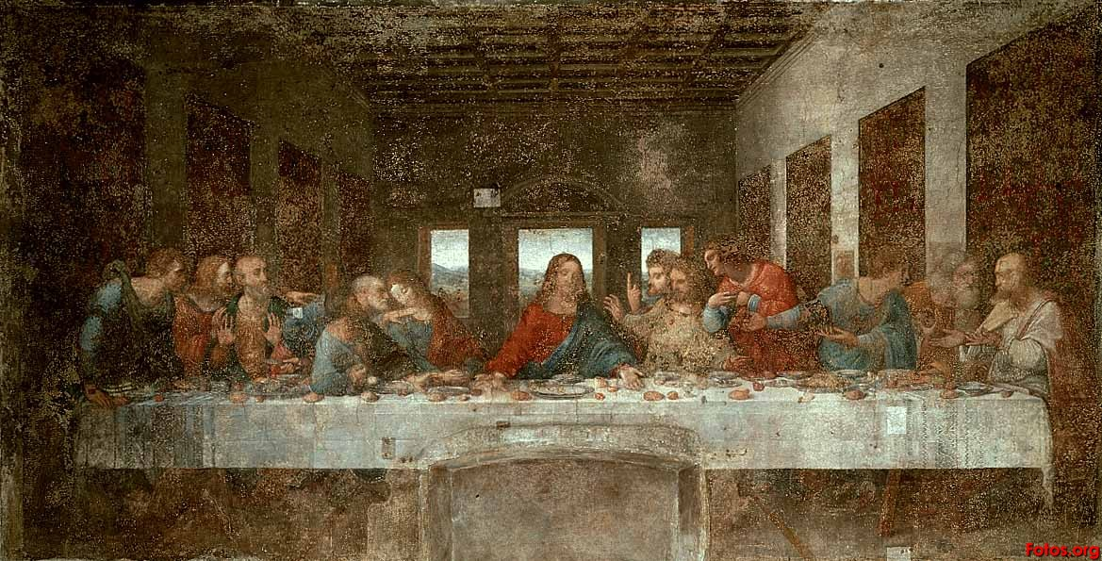
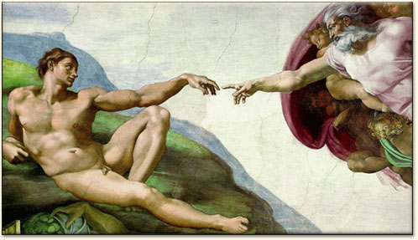
The Renaissance
Three geniuses of Renaissance Art
Leonardo Da Vinci
Michelangelo
Raphael
Italian Renaissance Writers
Machiavelli
The Prince 1513
A book about politics that is still referred to today
“The ends justify the means”
Notes:
The ends justify the means
Evil deeds that are done in order to do good are justified according to Machiavelli

Slide 7
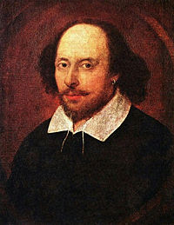
Renaissance Moves North
The Renaissance moves into Germany, France, England, Holland and most of Europe
Writers for a new audience
Rebelais – French author who wrote Gargantuan and Pantagruel
Shakespeare – considered the greatest author of all time
Cervantes – Spanish author who wrote Don Quixote
This book mocks medieval chivalry

Slide 8
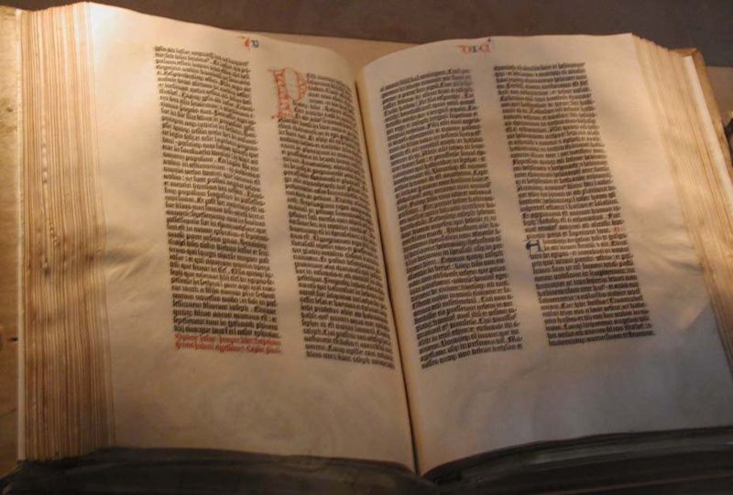
The Printing Revolution
Johann Gutenberg
German inventor
Created the first printing press
Books could now be mass produced
This allowed the bible to be mass produced
Before the printing press all books had to be hand written
More people learned to read
This helped educate all of Europe

Slide 9
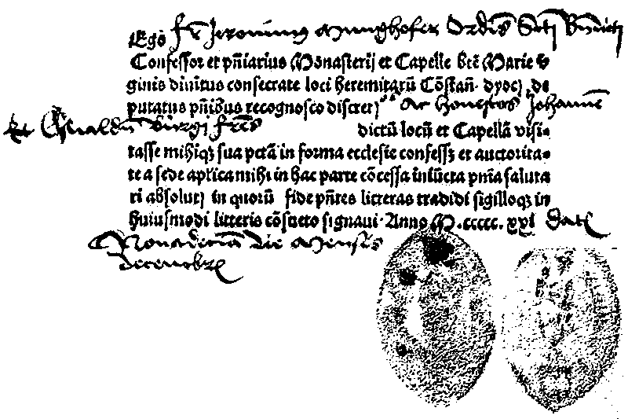
Abuses in the Church
Popes competed with Italian Princes for political power
Popes continued to live lavishly
Popes hired painters and sculptors to beautify churches
To finance these projects they had to raise money
Taxed marriage and baptism
Sold “Indulgences”
Payment to wash away sins

Slide 10
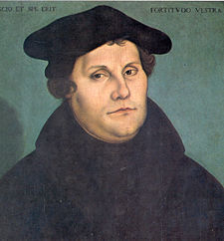
Martin Luther
German Monk (1517)
95 Theses posted on the door of the catholic church
Protesting the sale of indulgences among other things
Printing press allowed Luther’s 95 theses to be mass produced
Church called for Luther to recant
He did not and was excommunicated
The German king declared Luther an outlaw and made it illegal to give him food or shelter

Slide 11
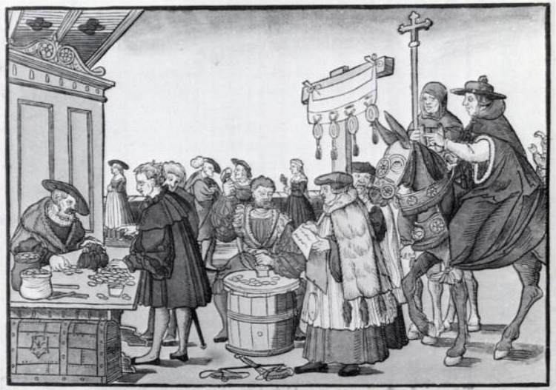
Martin Luther
Martin Luther went into hiding
His teachings became popular
Lutheran religion created
Faith alone would get you into heaven
Bible was sole source of religious truth
Luther denied the Pope or Priests were appointed from God

Slide 12
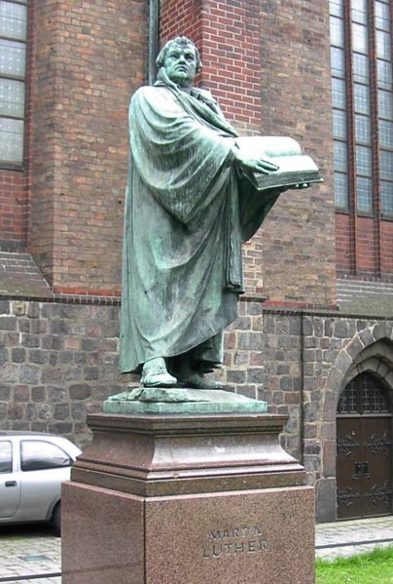
Martin Luther
Many saw Luther’s reforms as an end to the church’s corruption
1524 Peasants revolt
Revolt against the church
The peace of Augsburg
Allowed Princes to decide the religion of their nation (Catholic or Lutheran)

Slide 13
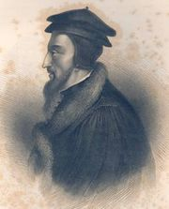
John Calvin
Another reformer
Believed in predestination
God had determined a long time ago who would be saved
Both Catholics and Lutherans opposed Calvinism

Slide 14
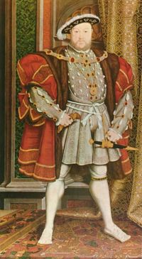
English Reformation
At first King Henry VIII (England) opposed any change to the Catholic church
When he wasn’t allowed to annul his first marriage he became angry with the church
Henry VIII takes over the church in England and executes any dissenters

Slide 15
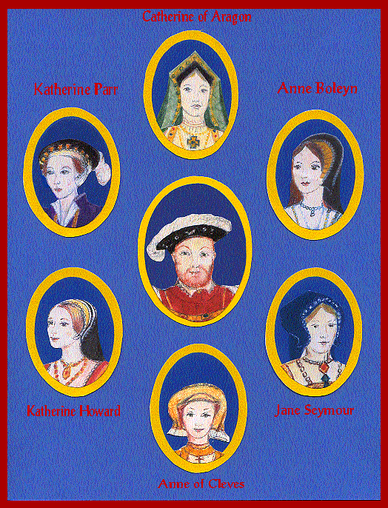
The Church of England
Henry VIII creates the Church of England
Annuls his first marriage
Henry VIII wants a son to become heir
Marries Ann Boleyn
Henry has her executed
Marries 3rd wife Queen Jane
Got engaged 1 day after Ann Boleyn execution
She dies of a fever
Notes:
Males decide the sex of the child
Henry had Anne arrested on charges of using witchcraft to trap him into marrying her, of having adulterous relationships with five other men, of incest with her brother George Boleyn, Viscount Rochford, of injuring the King and of conspiring to kill him, which amounted to treason. The charges were most likely fabricated. The court trying the case was presided over by Anne's own uncle, Thomas Howard, 3rd Duke of Norfolk. In May 1536, the Court condemned Anne and her brother to death, either by burning at the stake or by decapitation, whichever the King pleased. The other four men Queen Anne had allegedly been involved with were to be hanged, drawn and quartered; however, their sentences were ultimately commuted to decapitation. Anne and her brother George were also beheaded soon thereafter. At her final Mass, the Queen publicly swore to her innocence in the presence of a priest and various witnesses. She was also charged with the attempted poisoning of Henry FitzRoy, the illegitimate son of King Henry VIII.

Slide 16
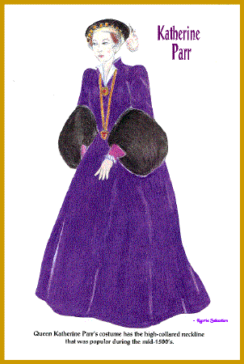
Henry VIII
Marries 4th wife Anne of Cleves
They divorce shortly after
Marries 5th wife Katherine Howard
She cheats on him and when he finds out she is executed along with two of her lovers
Marries 6th wife Katherine Parr
She outlives Henry

Slide 17
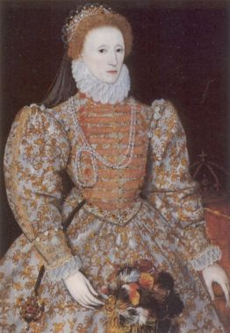
Religious Turmoil
Henry had son with 2nd wife
Edward is10 years old when Henry dies
He dies in his teens
Queen Mary takes over
She dies in 1558
Queen Elizabeth I takes over
Made England a Protestant nation

Slide 18
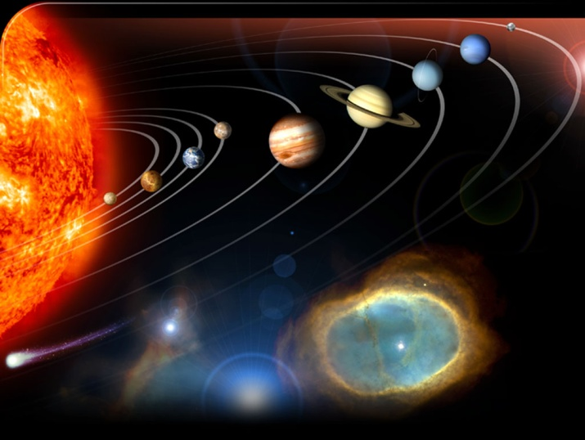
The Scientific Revolution
Ptolemy taught that the earth was the center of the universe
Copernicus came up with the theory that the universe was Heliocentric – planets revolved around the sun
Most religious thinkers rejected this theory

Slide 19
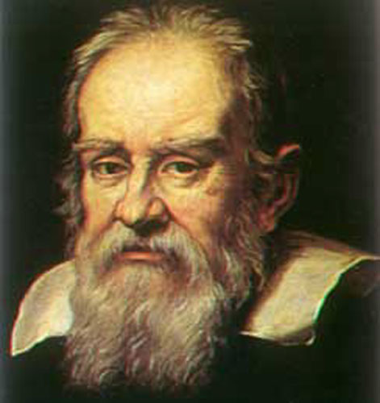
The Scientific Revolution
Galileo
Created the first telescope
Proved Copernicus was correct
The church tried him and told him to reject his heresies
In court he recanted
A new scientific method created
Problem, hypothesis, experiment, conclusion
Bacon and Descartes were leading scientists of the time
Descartes – “I think, therefore I am”

Slide 20
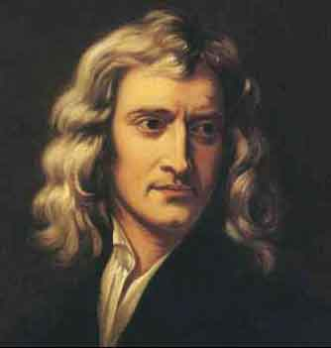
The Scientific Revolution
Newton ties it all together
Comes up with the mathematical explanation for gravity
Invented calculus
Chemistry was created
Used to be known as magic
First real advances in medicine
Anatomy became a real science

